Slide 2
Introduce Yourself
St. Joseph’s, Computer Information Technology Major, Business Minor, Senior
Coding, Photo Editing, and Graphic Design
After I graduate I plan on re-enrolling into St. Joseph’s to join their graduate Computer Forensics Program.
My goal is to have a job in one of the renowned intelligence agencies in our country

Slide 3
Enterprise Data Management
The purpose of the EDM is to maintain Master Data accurately and continually across Estee Lauder to enable their operation to occur on a consistent basis.

Slide 4
The Goal of EDM
Clean Data
Establish Organization Model focused on stewardship and accountability
Implement Robust Online Workflow / Automation Tools
Establish a Single Version of Truth

Slide 5
What is a Data Lake?
A Data Lake is an effective data-driven method for capturing a wide range of data types.
A massive, easily accessible, centralized repository of structured and unstructured data.
Is optimized for quick ingestion of raw data as well as the processing of such data.
Makes it possible to store Data as-is, where as a Data Warehouse can only accept structed Data.

Slide 6
Single Version of Truth
The end goal of the Data Lake is to provide a space for all sanctioned data so that the company will be using data from a single source. (Single Version of Truth)
Having a Single Version of Truth allows for business teams and Senior Management to have full confidence in the integrity of the holistic view of the data.
While on the EDM team I supplied multiple teams with the correct data elements they had requested for their current on going projects.
Consumer Snapshot
P&L
DAM
H2R

Slide 7
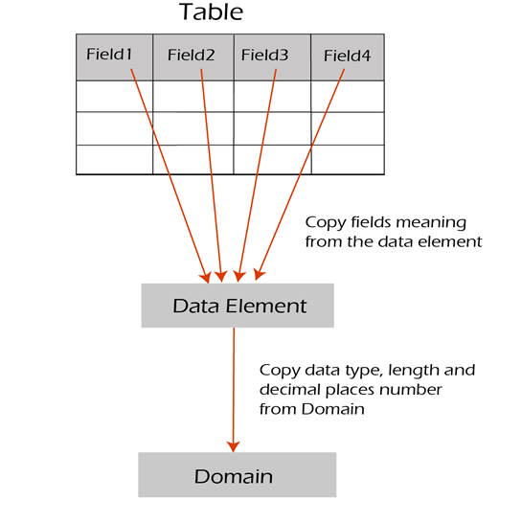
What is a Data Elements
A Data element is what describes an individual field in a SAP Table.

Slide 8
Supplying the Data Elements
To supply teams with the Data Elements they requested I had to use SAP to find and download the tables they reside in.
EDM has declared that SAP ECP is our current Source of Truth (SoT), and that BI – HANA is our System of Record (SoR).
Meaning that if applicable, I would supply the teams with both the SoT and SoR when a request is made.

Slide 9
Reflection
Did you enjoy your first placement? (Be honest but kind ☺)
My time on the EDM team was my first experience in the professional world and I enjoyed every second of it.
I have learned so many things while working on projects with them and I am grateful for the experience

Slide 10
Reflection
Reflect on your overall experience working 34 hours a week in Corporate Finance for The Estee Lauder Companies.
As you begin considering your career path; what effect has this experience had on you?
Have plans for your future changed? or were you right all along?

Slide 11
Reflection
Suggestions? Comments? Concerns?
Tell us how we can improve the program next year?
OR
Tell us about your (least) favorite event and why you did (not) like it
What would make your (least) favorite event better?

